Slide 1

E-Office Presentation
IT Department
03/06/2025

Slide 2
What is e-Office?
Project under the National e- Governance Plan.
Developed by National Informatics Centre (NIC)
Digital workplace solution to streamline and modernize
government operations, as a part of Digital India
Programme.
E-Office is a web based software where the Physical files
can be replaced with Digital file .
Facilitating Paperless Office.

Slide 3
Objectives
Promote Paperless Governance
Real-time file movement and tracking.
Enable Faster Decision Making.
Enhanced accountability and transparency.
Ensure data security and Integrity.
Facilitate Anytime, Anywhere Access.
Improve monitoring and Supervision.

Slide 4
Key Modules in e-Office
File Management System (FMS)
Knowledge management System (KMS)
Leave Management System
Personnel Information Management System (PIMS)

Slide 5
Implementation Status at PMC
Department Configured :- 36
Total eOffice Users :- 527
Training Sessions :- 80
Total e-File Count :- 424

Slide 6
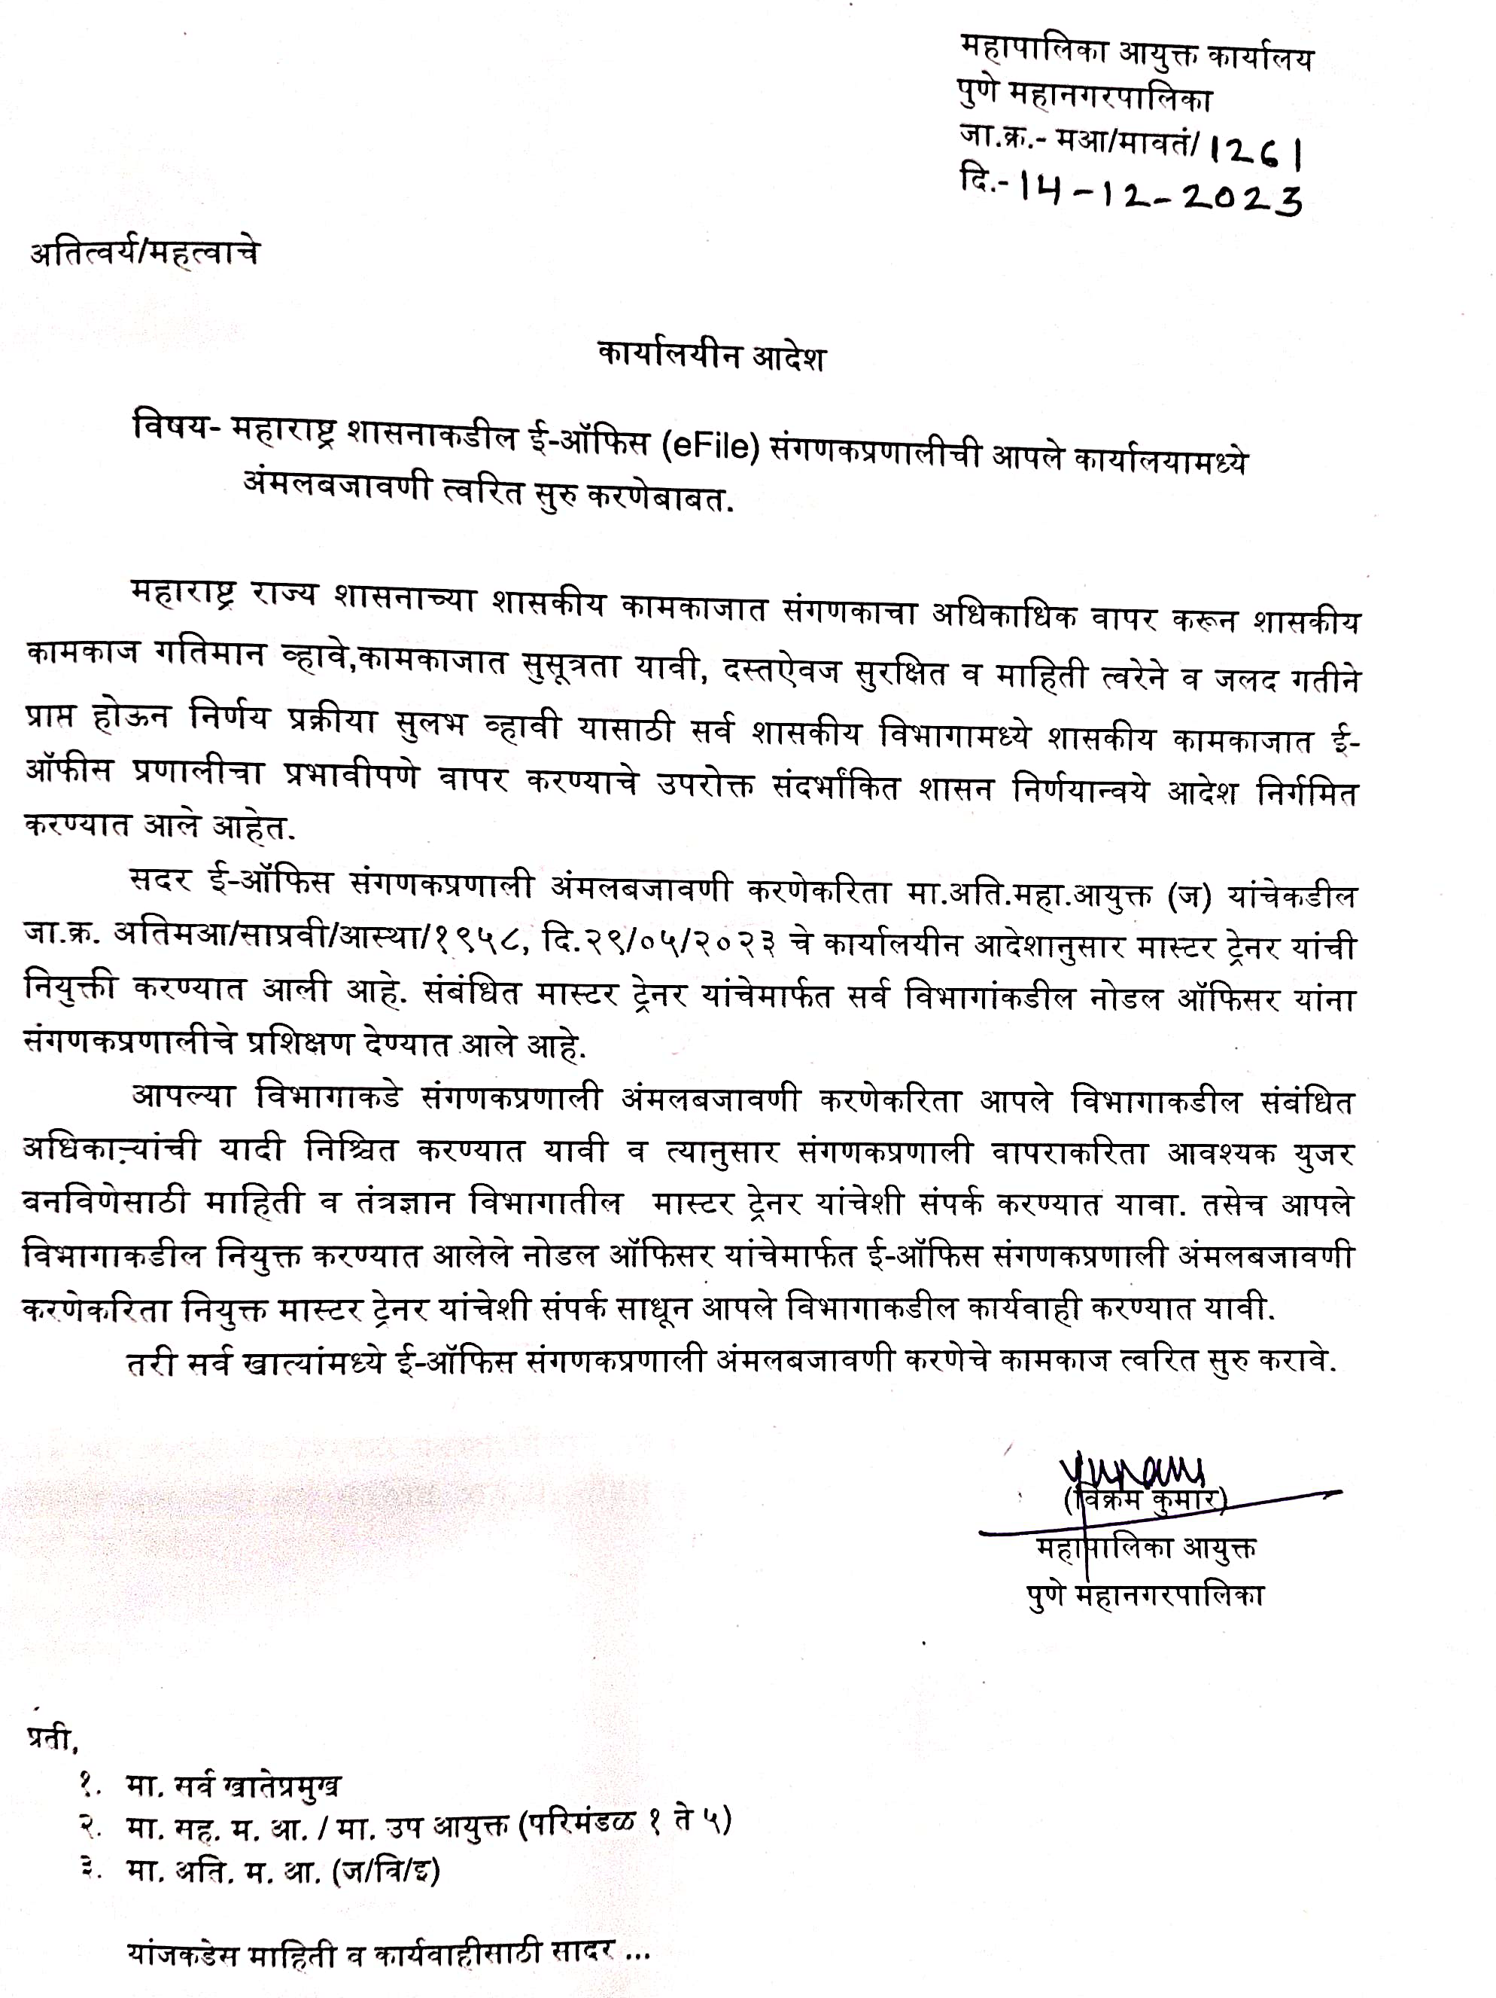
E-office circular

Slide 7
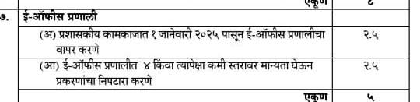
CM’s100 Days Program

Slide 8
Login Procedure of e-Office

Slide 9
eoffice.pmc.gov.in
Enter PMC eOffice Website

Slide 10
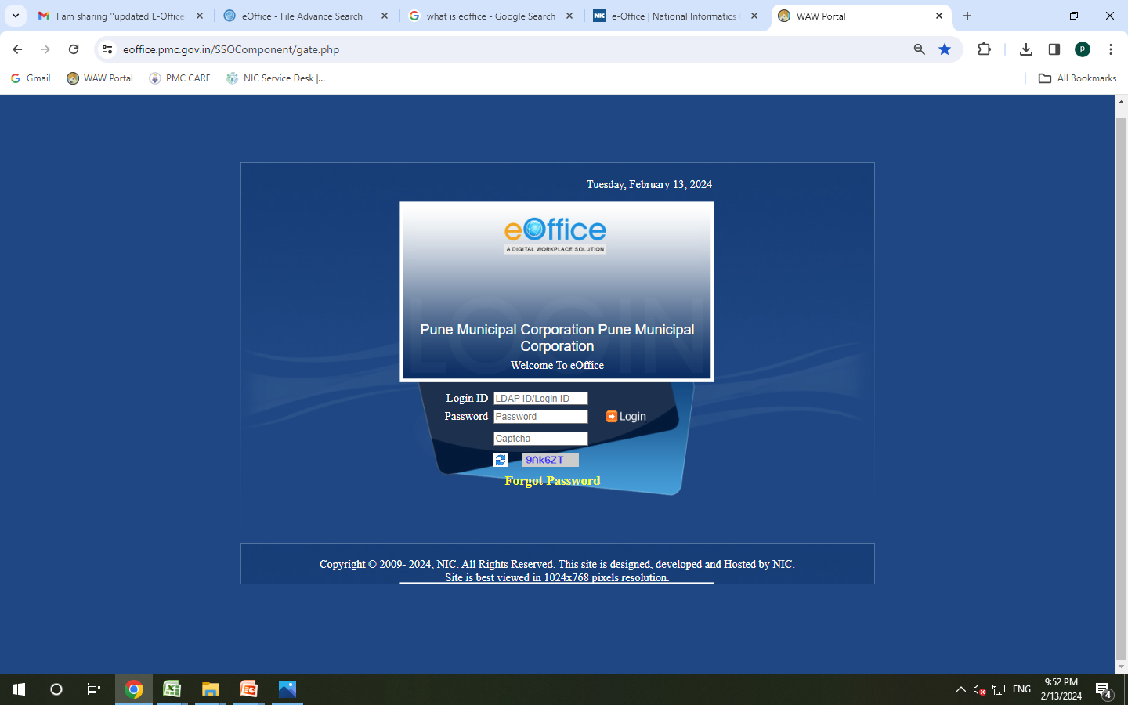
E-Office Log In Page

Slide 11
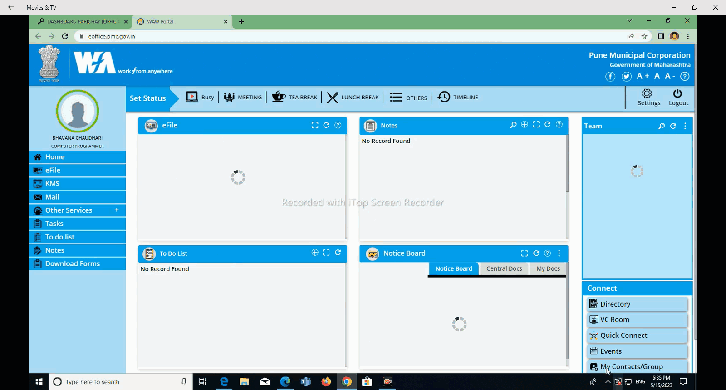
e-Office Homepage

Slide 12
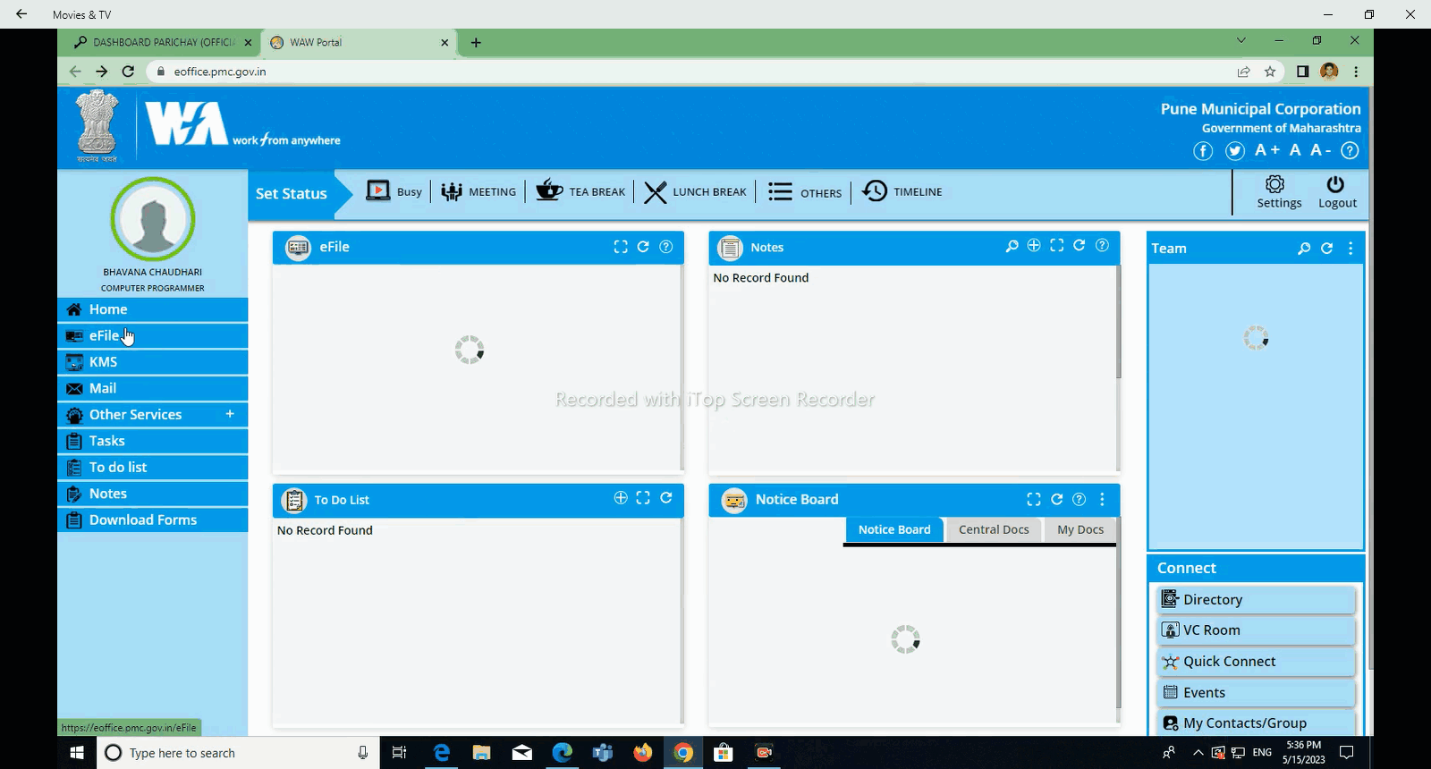
Click On e-File Option For create e-files & Receipts.

Slide 13
How to Create
e-File
In e-Office??

Slide 14
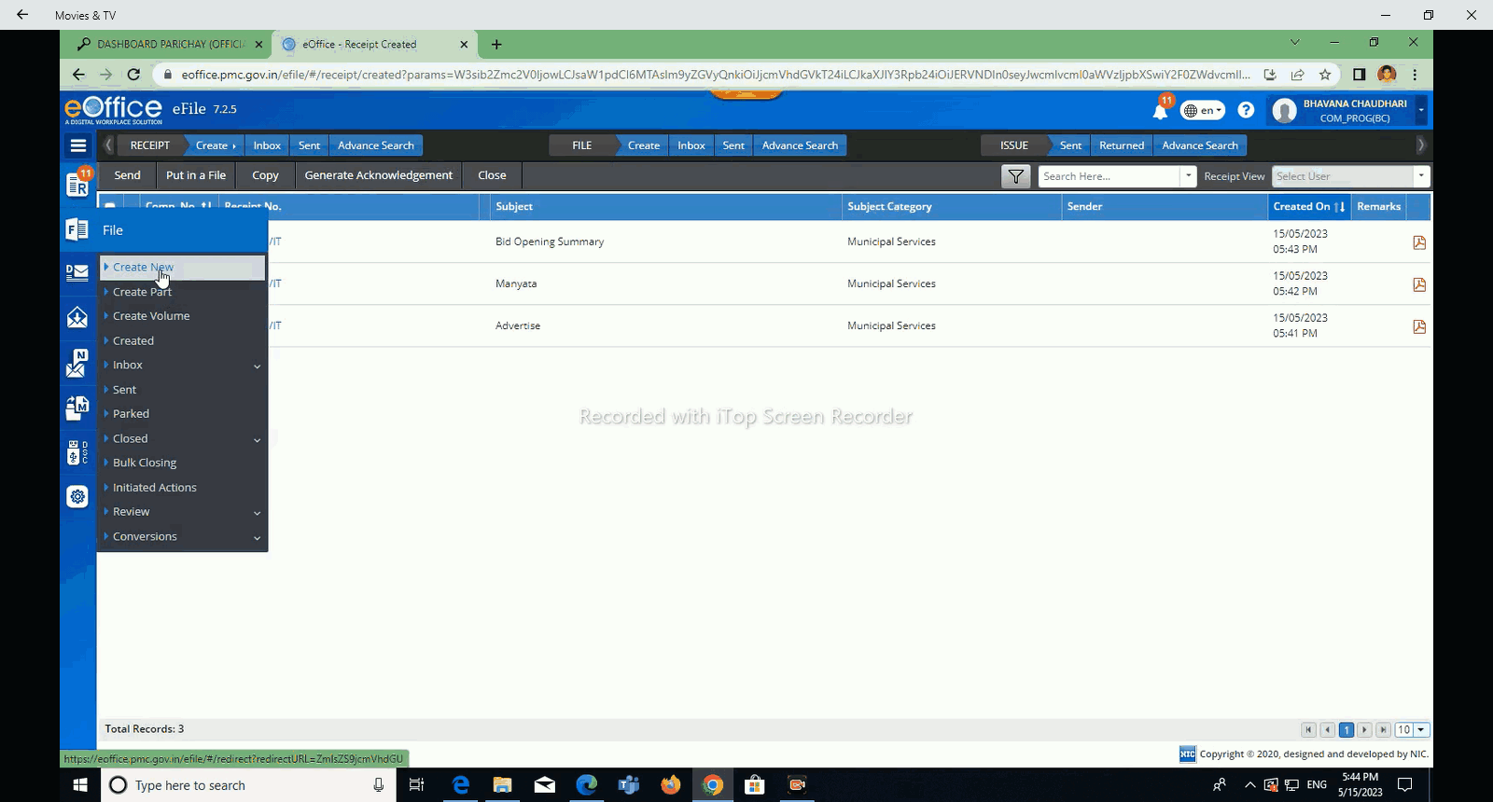
Click on Create New File

Slide 15
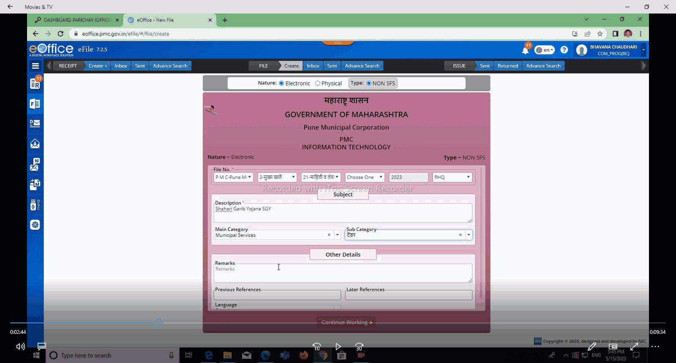
Fill All Mandatory Data & Click on Continue Working

Slide 16
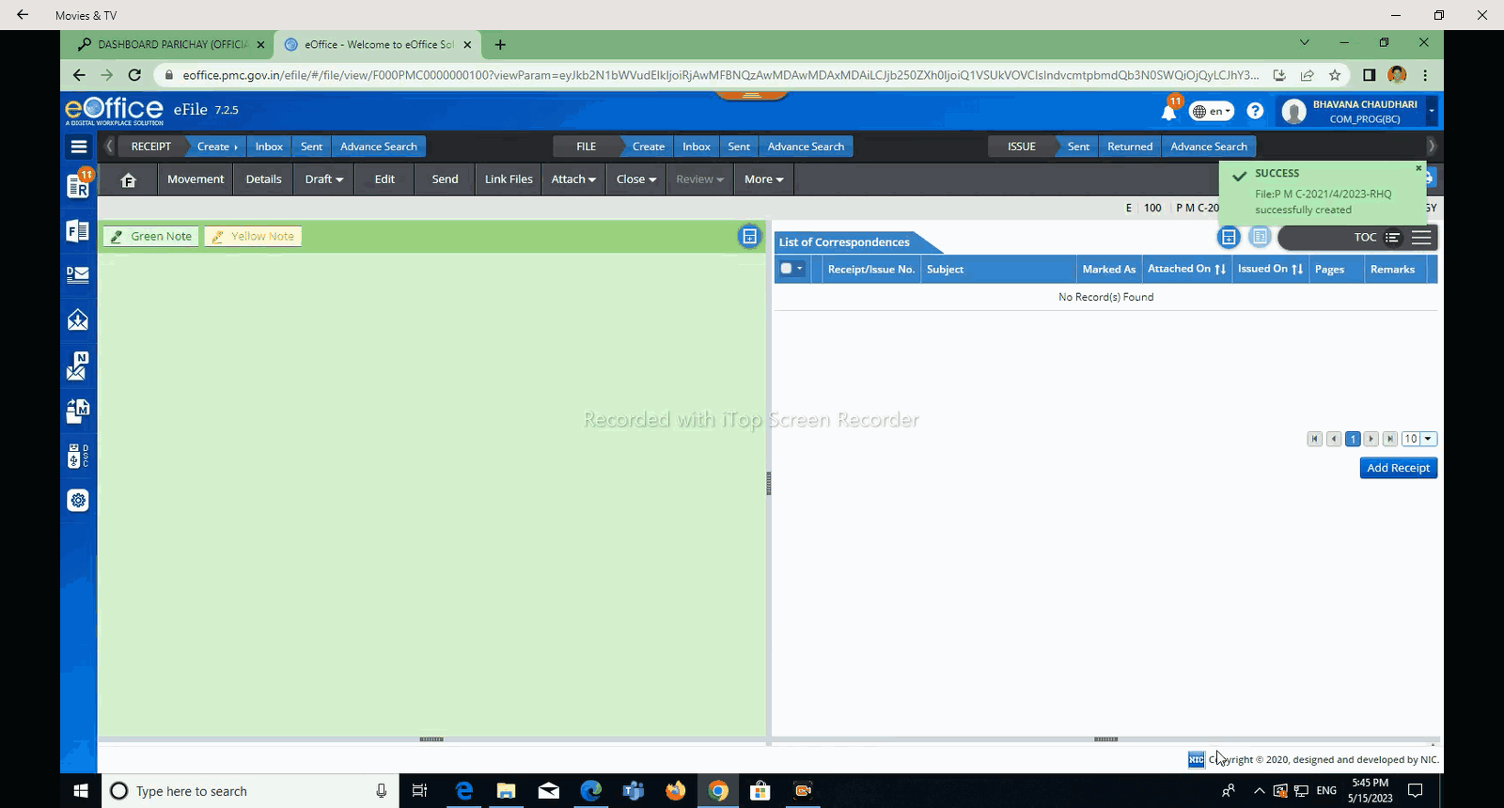
File Created Successfully

Slide 17
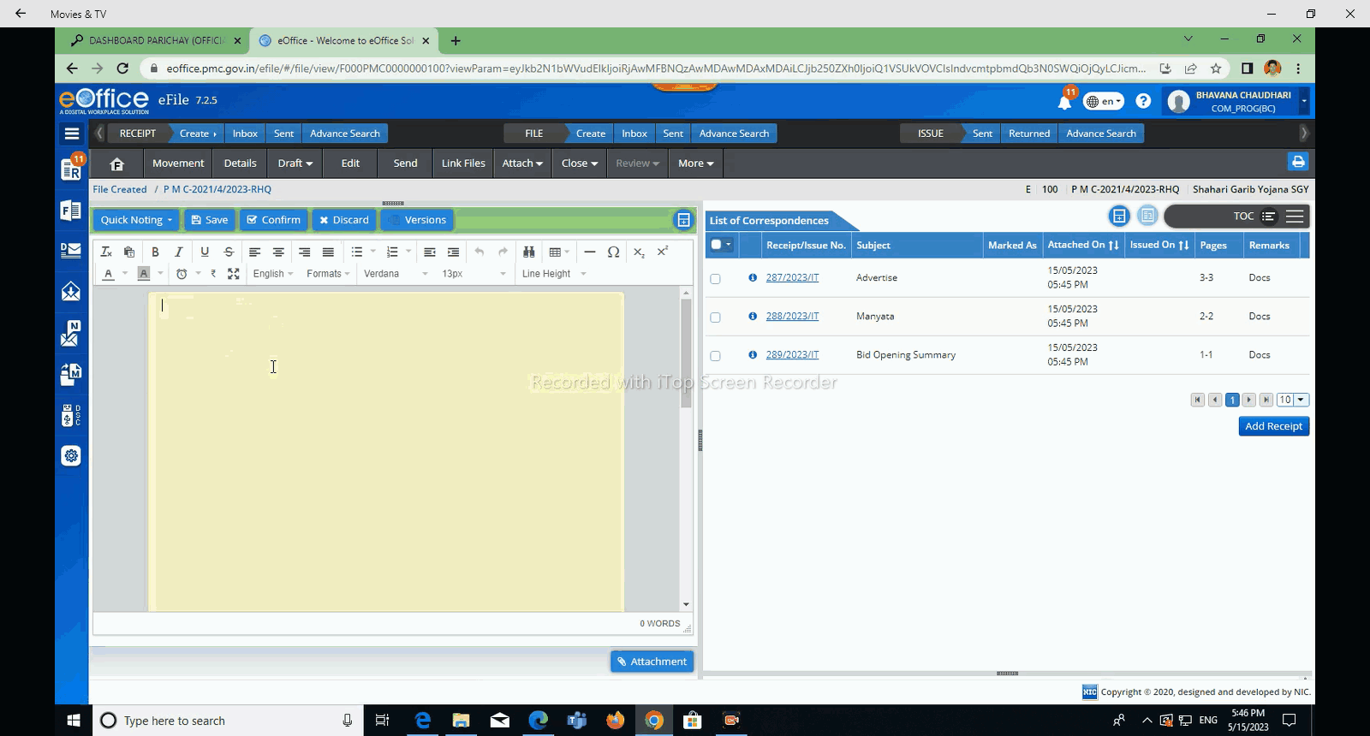
Drafting Part
Attached Scanned Documents to file from ‘Add Receipt’ Button.

Slide 18
How to Create
Receipt
In e-Office?

Slide 19
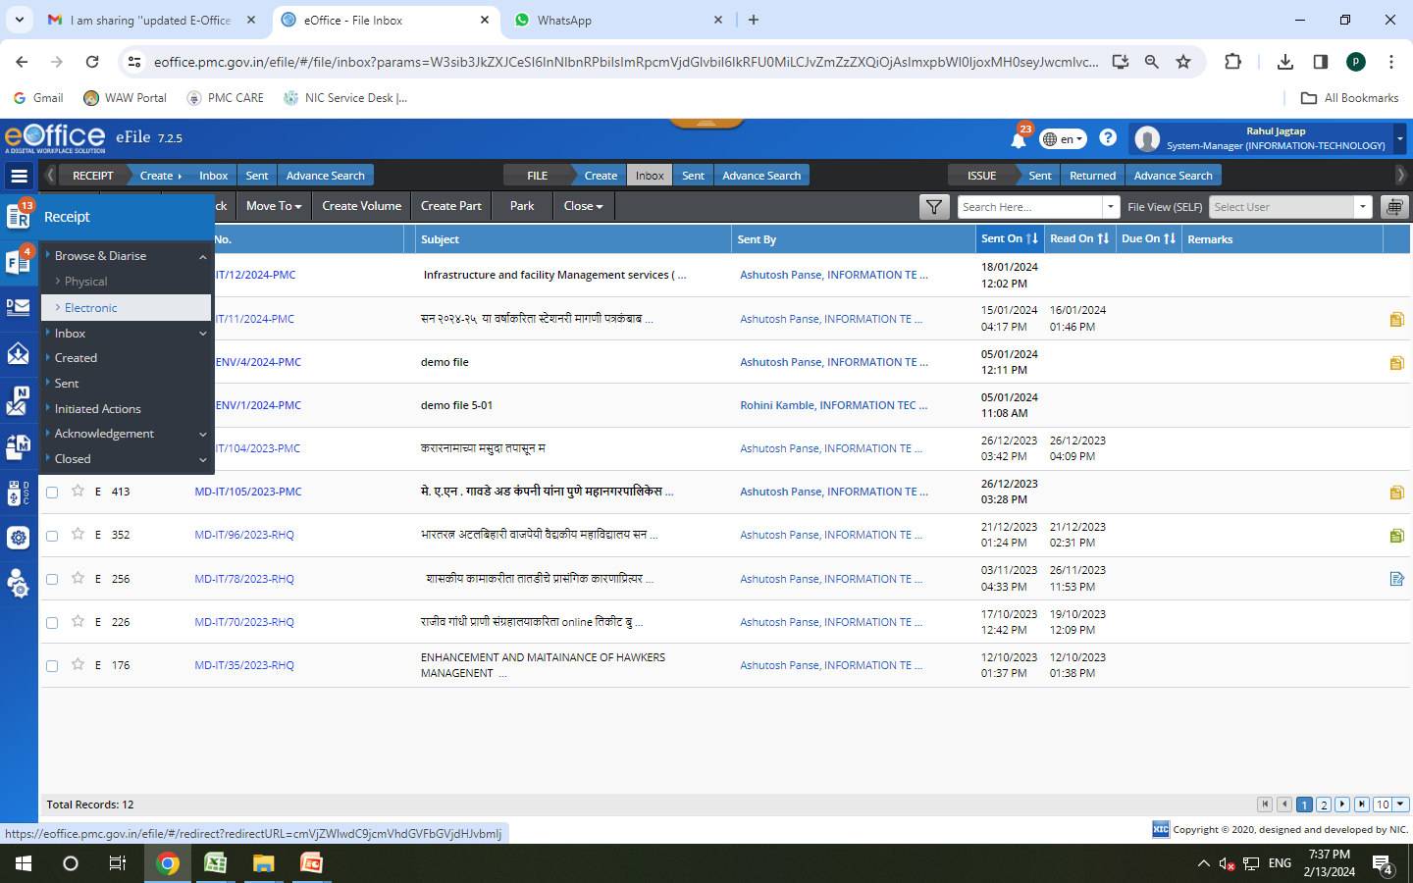
Click on Receipt Button & select Browse & Diaries

Slide 20
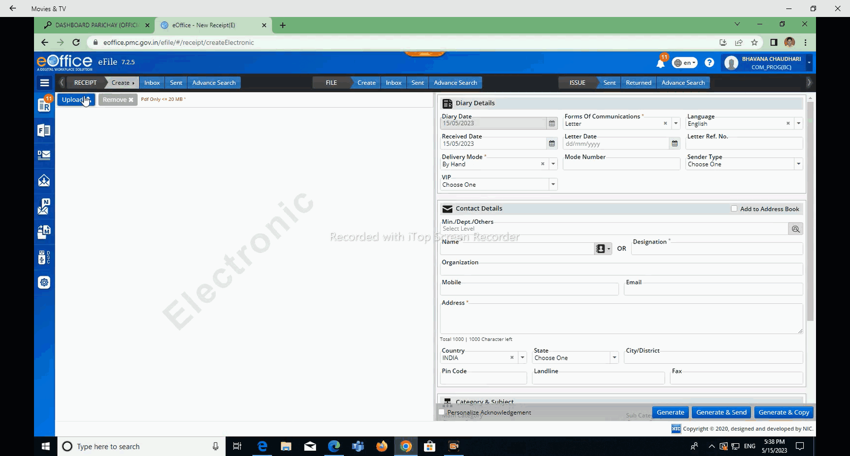
Click Here To Upload Document

Slide 21
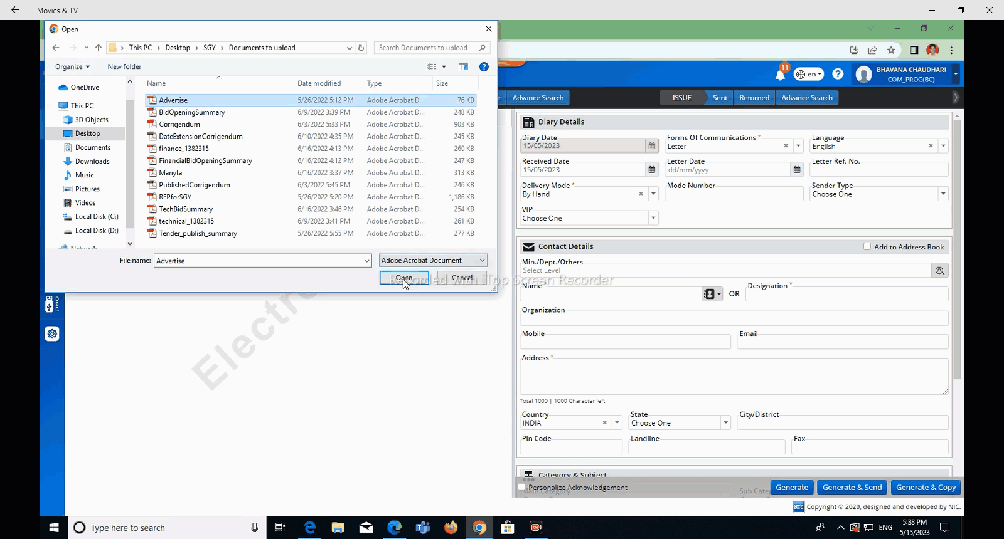
Choose File & Open It

Slide 22
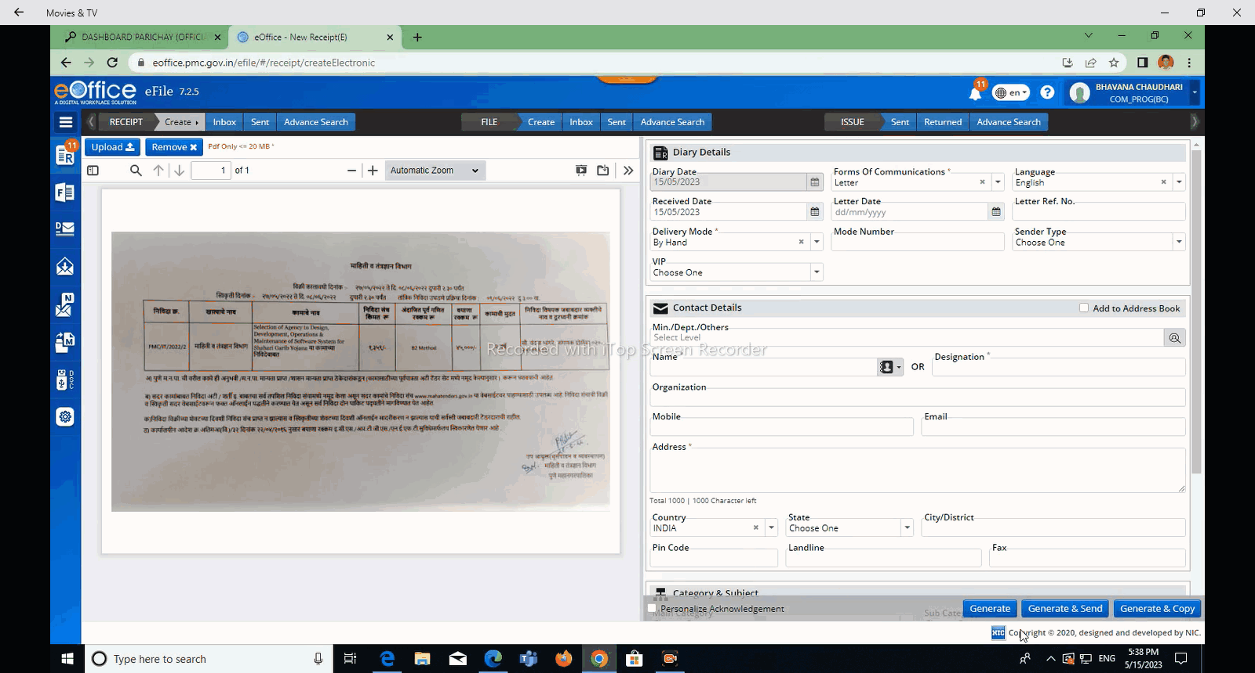
This Is Uploaded PDF document

Slide 23
On Right Hand Side, Fill All Mandatory Data

Slide 24
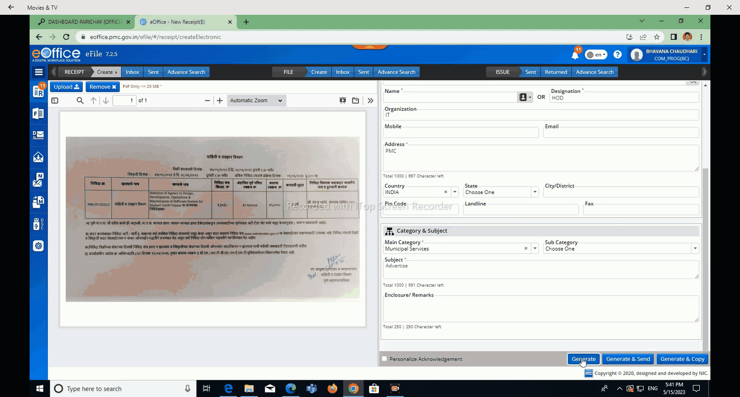
Generate Button for Storing Document in Account.
Send button Document Immediately.
Generate & Copy for Multiple Copies of Document.

Slide 25
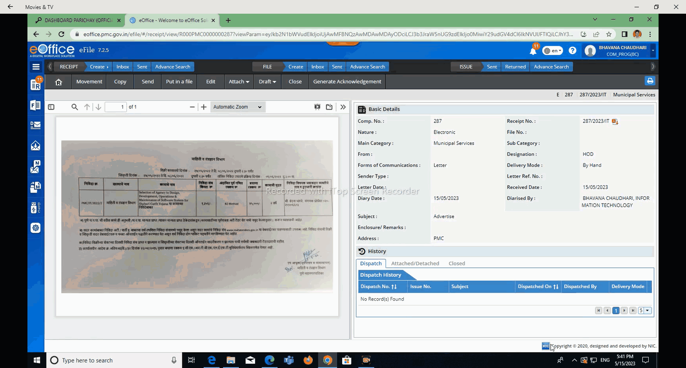
Unique Receipt No generated

Slide 26
Process of How to
Send Files
In e-Office

Slide 27
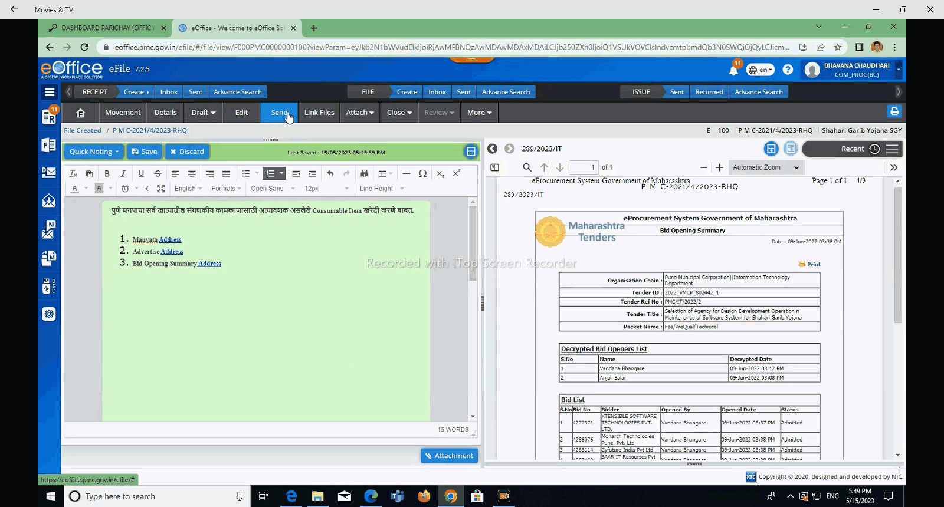
Click On Send Button For Sending File

Slide 28
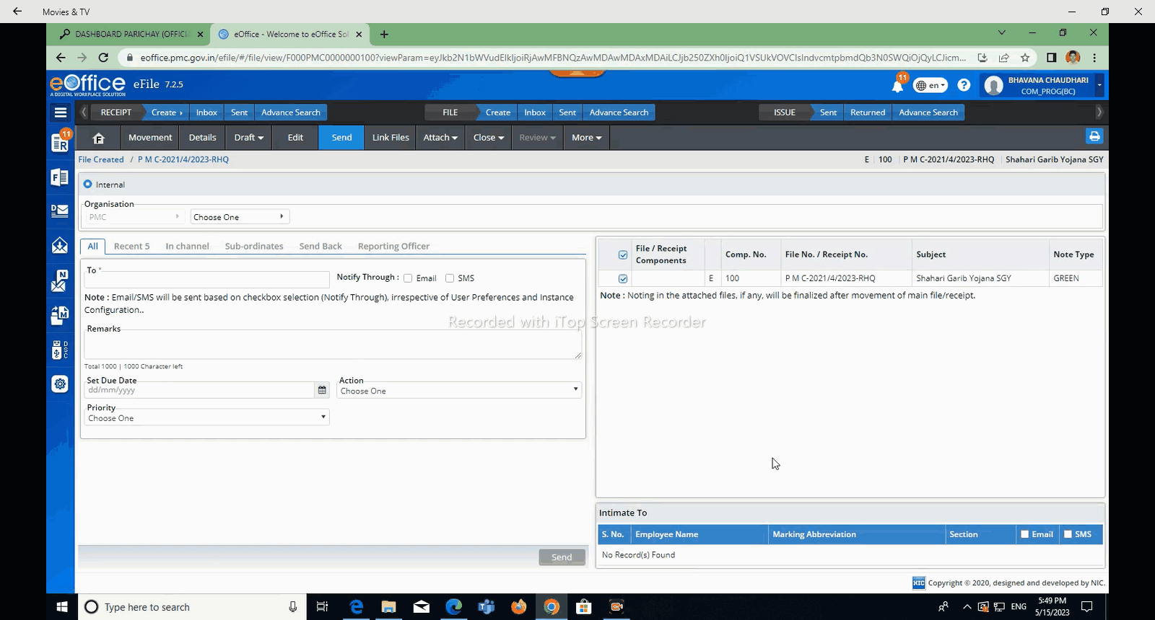
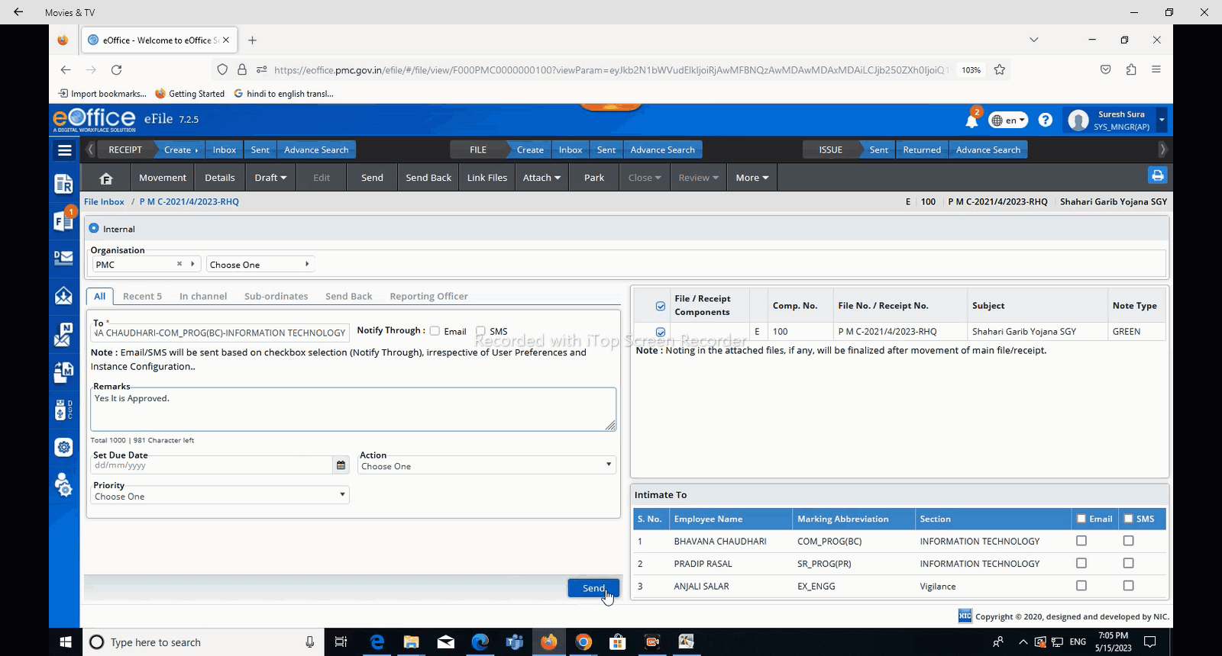
Select department from here
Click On Send Button

Slide 29
How to find Incoming file in E-office??

Slide 30
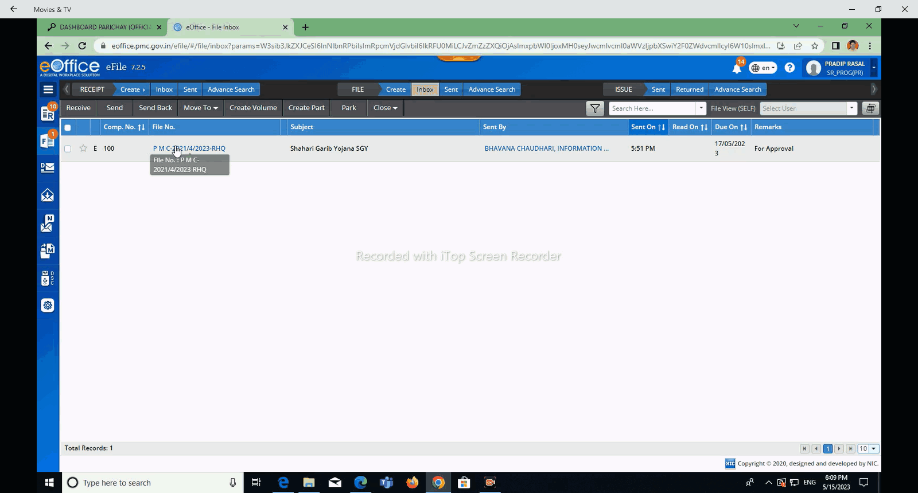
Click Inbox to see incoming files.

Slide 31
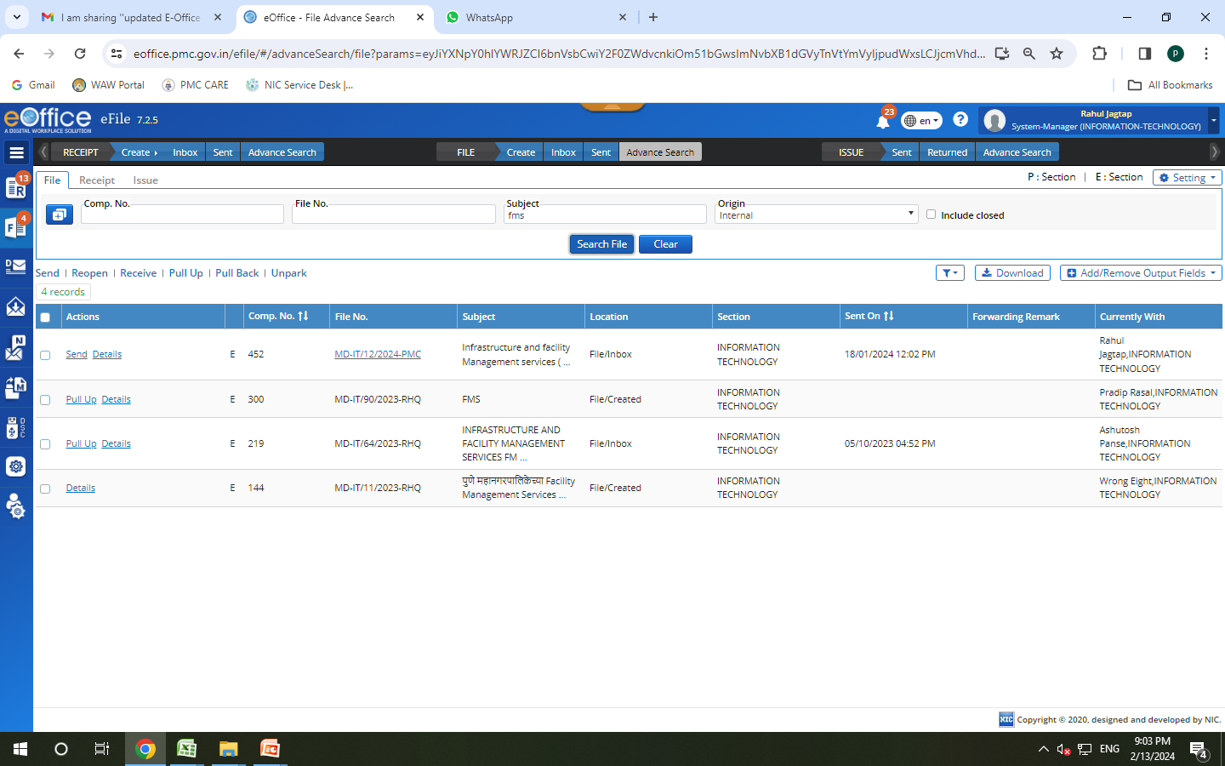
Click Advance Search to Search e-Files

Slide 32
E-sign Registration Process

Slide 33
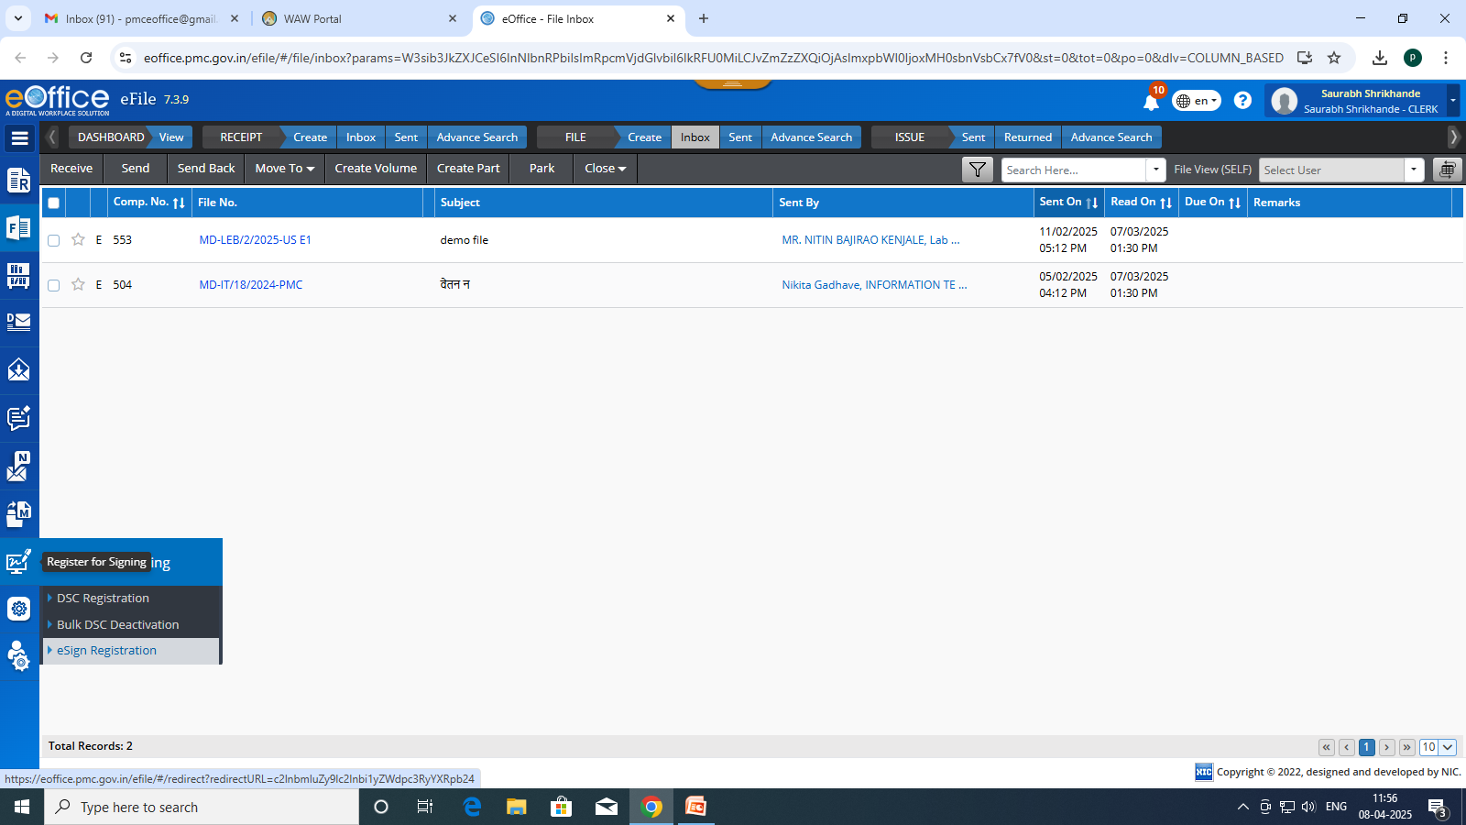
Click on Register for Signing Option.

Slide 34
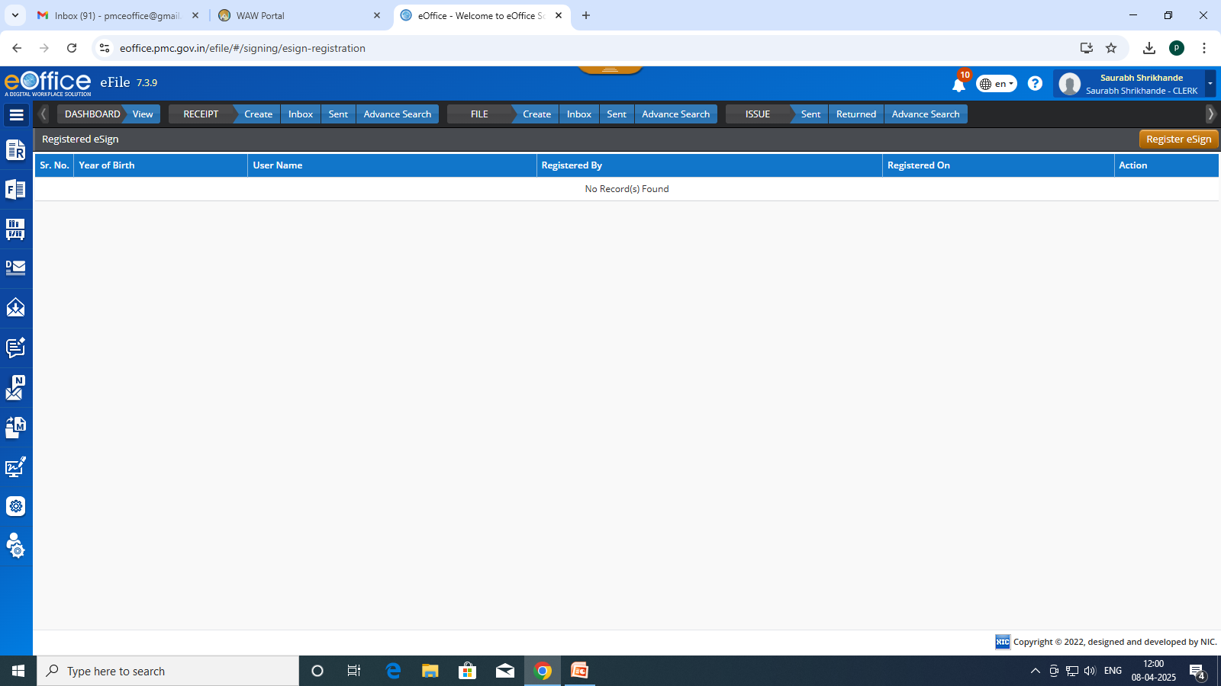
Click on Register e-Sign Button

Slide 35
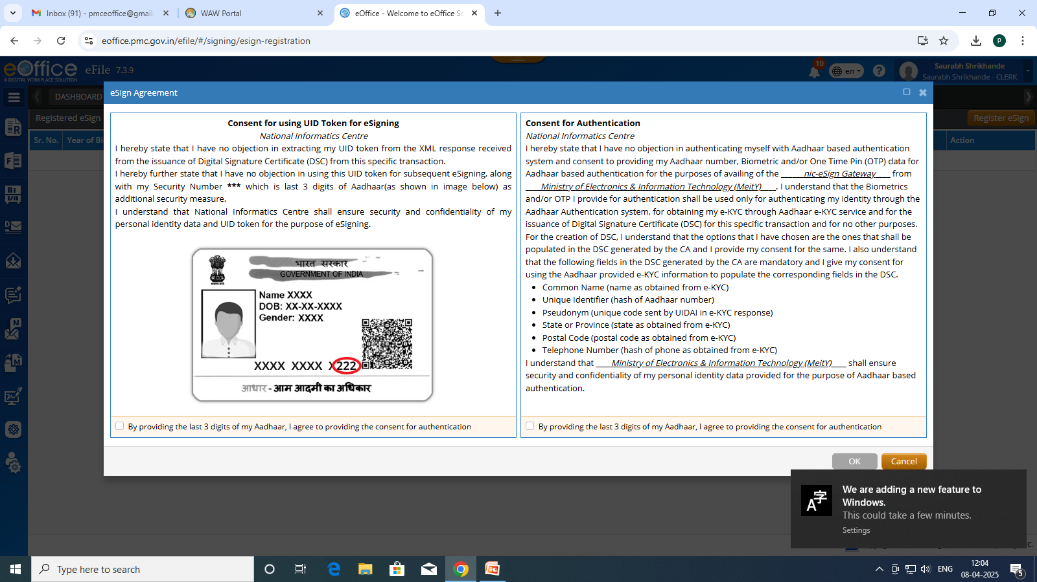
Click on both check box for Consent for Authentication.

Slide 36
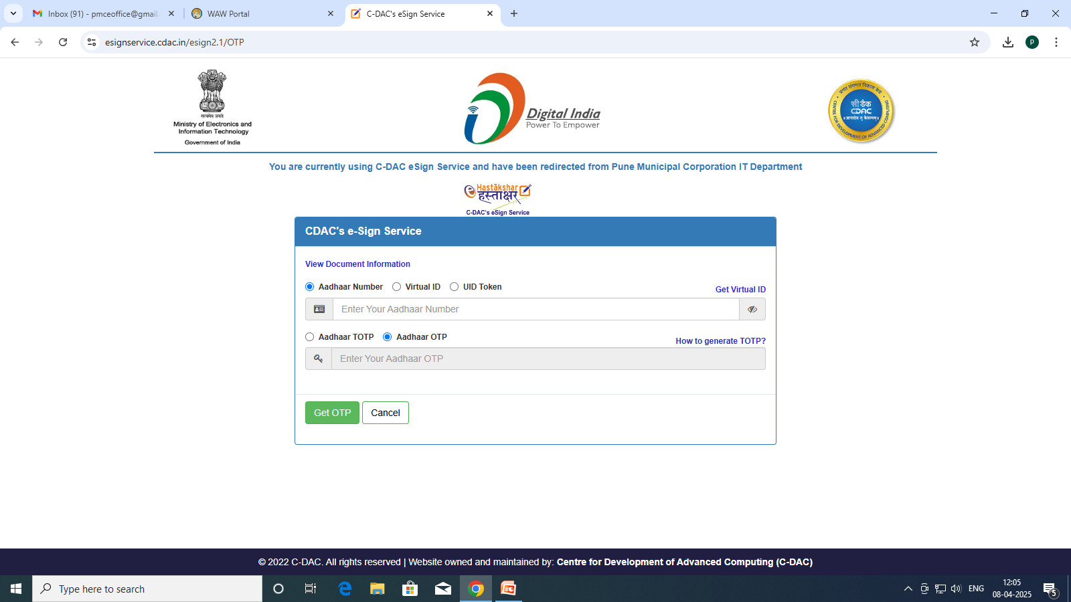
Enter Aadhar No. & then click on Get OTP Button

Slide 37
Conclusion
E-Office is a step towards “Digital PMC”
Encourages transparency, speed, and citizen centric governance
Continued support and engagement from all stakeholders is crucial.

Slide 38
Question and Answers

Slide 39
THANK YOU…..

